Slide 1
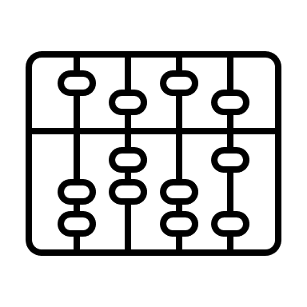
Solving Problems Divide and Conquer with Recursion
CS 1181 – Computer Science II
Dr. Michael Raymer
Lecture materials adapted from:
ZyBooks ISBN: 979-8-203-16123-9 Dr. Cay Horstmann, Univ. of Michigan Dr. Roman Lysecky, Univ. of Arizona
Dr. Adrian Lizarraga, Univ. of Arizona
Dr. Travis Doom
Dr. Michelle Cheatham
Unless otherwise noted images are used under the creative commons license or used under license from Adobe Stock.

Slide 2
Two kinds of Computer Science jobs:
1) Design, Build, Test, Repeat
2) Solving Problems

Slide 3
Ways to solve problems (Algorithm Types)
Exhaustive (brute force)
Greedy
Divide and Conquer
Heuristic, randomized, graph, and more…

Slide 4

Example: Traveling Salesman
B
2
2
A
6
C
12
7
45
8
9
2
F
2
2
D
E
Notes:
A-B-D-C-F-E-A = 30

Slide 5
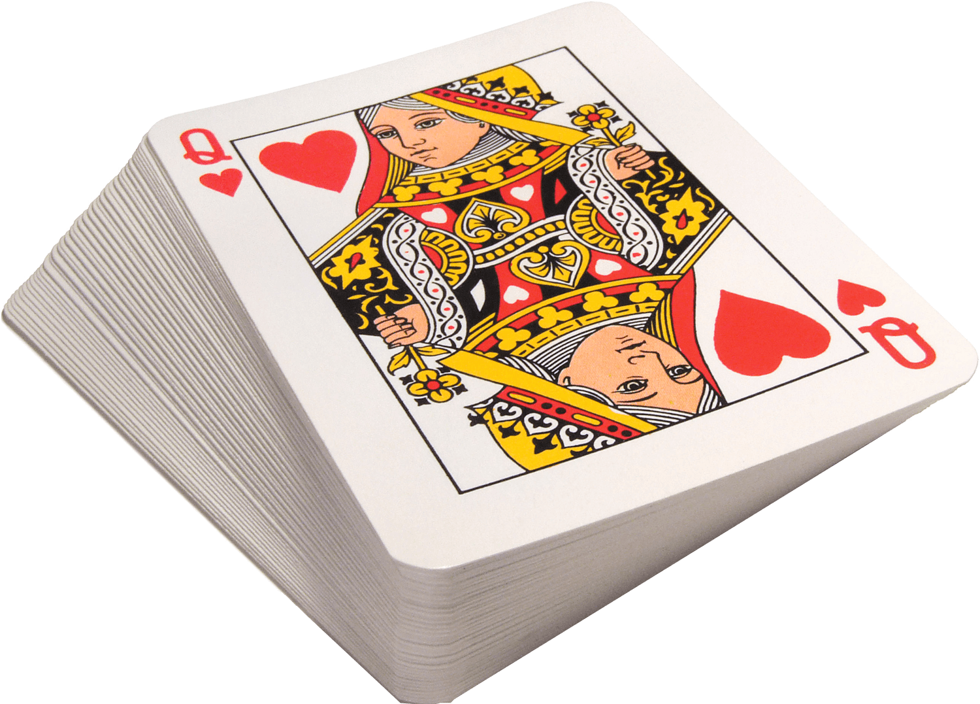
Example: Search
Find the seven of diamonds
Notes:
If I give each table a deck of cards and ask you to find the seven of diamonds, how would you do it?

Slide 6
What will happen when I call this method?
public static void ohNo(){
System.out.println("Oh no!");
ohNo();
}
How do we fix this?

Slide 7
The Base Case
No recursive call!
public static void ohNo(int count){
// Base case: no more than 100 times
if (count > 100){
System.out.println("Ok, thats enough.");
}
else {
System.out.print("Called ohNo " + count + "times");
ohNo(count+1);
}
}
Recursive call

Slide 8
Is this useful?
Write a method to reverse a string.
String: university
1) Reverse this part:
niversity
ytisrevin
u
2) Add the first character
Notes:
The problem breaks down into a smaller version of itself: Divide & Conquer!

Slide 9
Reverse Algorithm
public static String reverse(String theString){
String firstChar = theString.substring(0, 1);
String theRest = theString.substring(1));
return(reverse(theRest) + firstChar);
}
// Base case:
if (theString.length() == 0){
return theString;
}
Can it really be that easy? What’s missing?

Slide 10
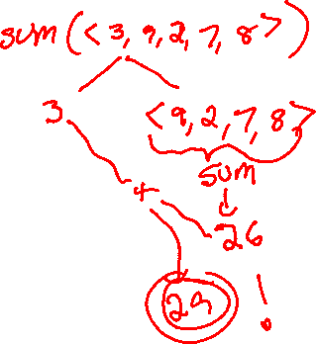
Designing Recursive Algorithms
Divide and conquer
How can I divide the problem into smaller versions of the same problem?
Base case
What is the base case?
Have faith!
Assume your method works and use it.
Put the pieces together
Add the parts to form a solution.

Slide 11
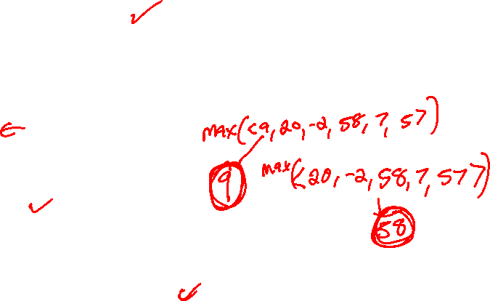
Designing Recursive Algorithms
Divide and conquer
How can I divide the problem into smaller versions of the same problem?
Base case
What is the base case?
Have faith!
Assume your method works and use it.
Put the pieces together
Add the parts to form a solution.

Slide 12









public static int sum(ArrayList<Integer> theList){
if (theList.size() == 0){
return 0;
} else {
return theList.remove(0) + sum(theList);
}
}
public static int sum(ArrayList<Integer> theList){
if (theList.size() == 0){
return 0;
} else {
return theList.remove(0) + sum(theList);
}
}
public static int sum(ArrayList<Integer> theList){
if (theList.size() == 0){
return 0;
} else {
return theList.remove(0) + sum(theList);
}
}

Slide 13
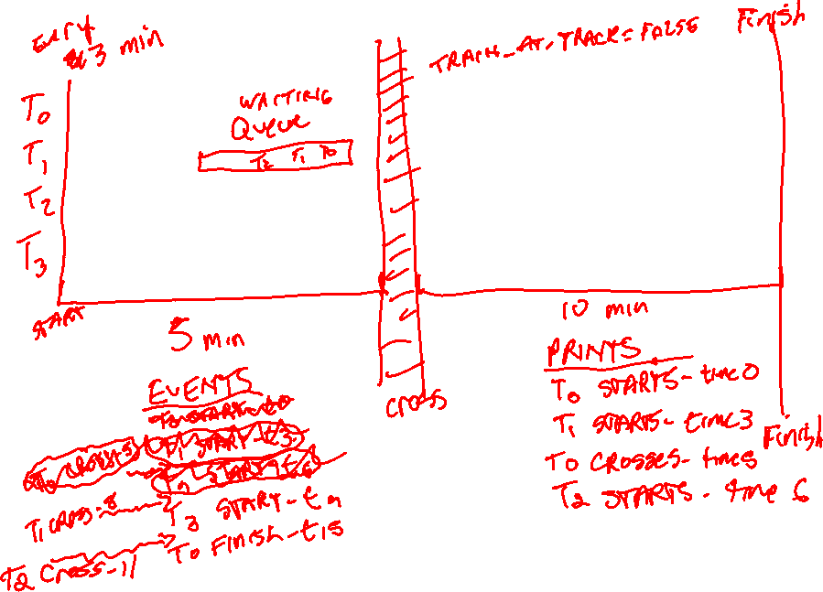

Slide 14
How can this work?
pots
public static String reverse(String theString){
if (theString.length() == 0){
return theString;
}
String firstChar = theString.substring(0, 1);
String theRest = reverse(theString.substring(1));
return(theRest + firstChar);
}
p
ots
ots
public static String reverse(String theString){
if (theString.length() == 0){
return theString;
}
String firstChar = theString.substring(0, 1);
String theRest = reverse(theString.substring(1));
return(theRest + firstChar);
}
Trace it and find out

Slide 15
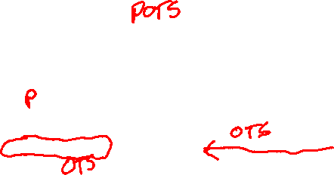
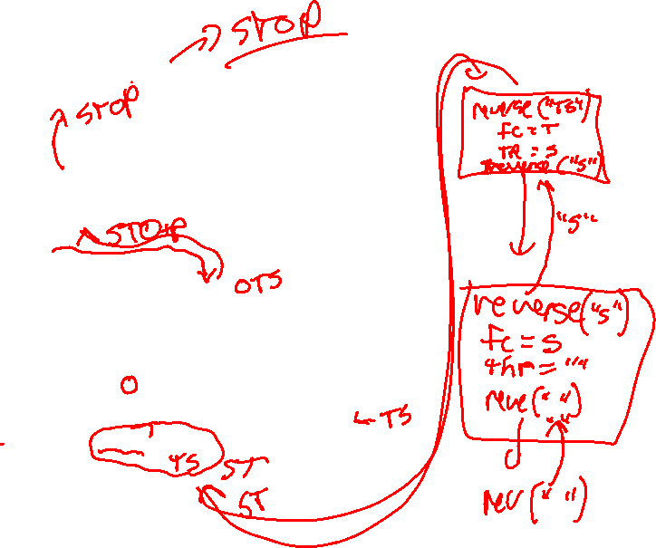
public static String reverse(String theString){
if (theString.length() == 0){
return theString;
}
else {
String firstChar = theString.substring(0,1);
String theRest = theString.substring(1);
return reverse(theRest) + firstChar;
}
}
public static String reverse(String theString){
if (theString.length() == 0){
return theString;
}
else {
String firstChar = theString.substring(0,1);
String theRest = theString.substring(1);
return reverse(theRest) + firstChar;
}
}

Slide 16
Recursive examples
public static void learnRecursion() {
if (iUnderstandRecursion() == true) {
System.out.println(“Congratulations!”);
}
else {
practiceRecursion();
learnRecursion();
}
}

Slide 17
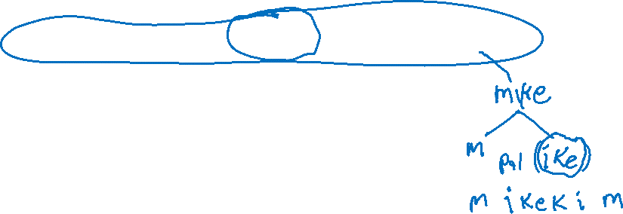
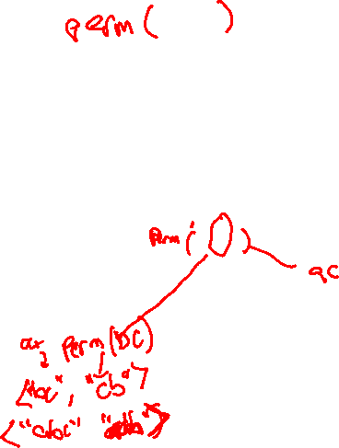
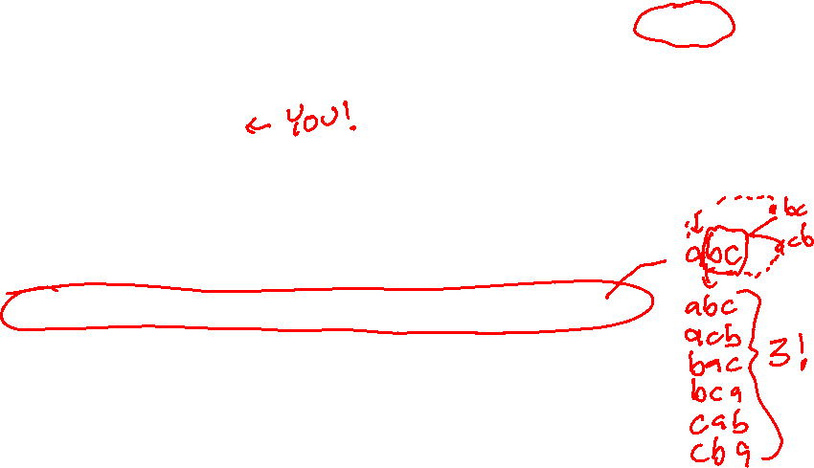

Recursion examples
Palindrome(): “mike” → “mikekim”
sum(List<Integer> list)
max/min(List<Integer> list)
factorial()
power(value, exponent)
sort(List<Integer> list)
permutations(String theString)
scramble()

Slide 18
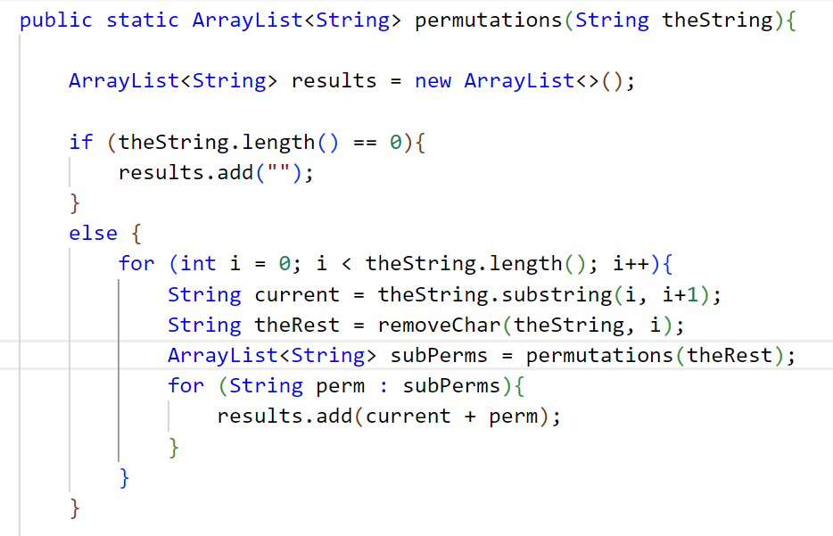
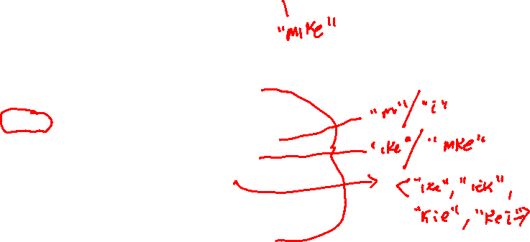

Slide 19
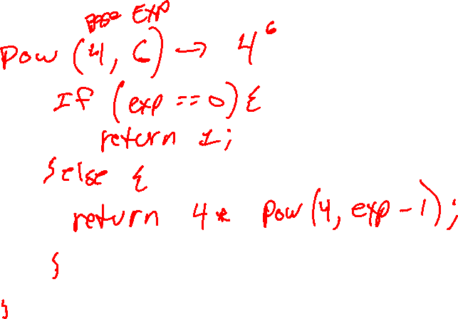

Slide 20
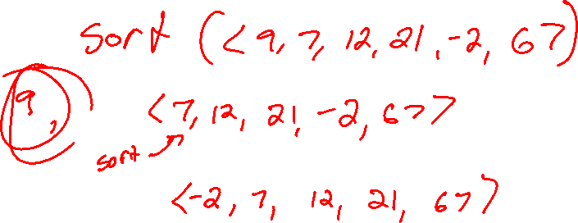

Slide 21
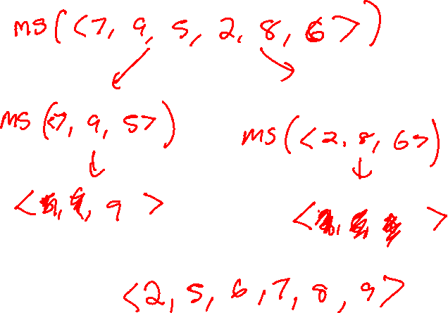

Slide 22
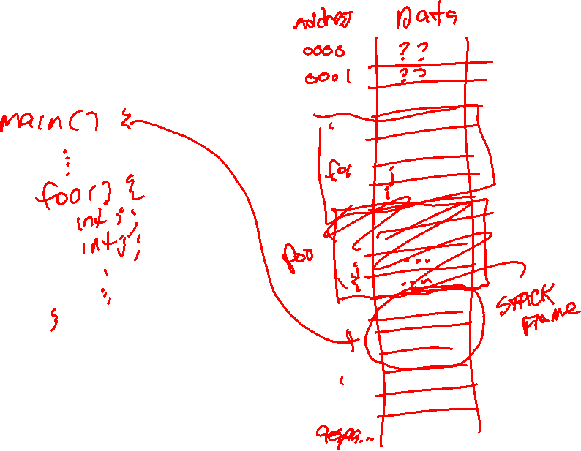

Slide 23
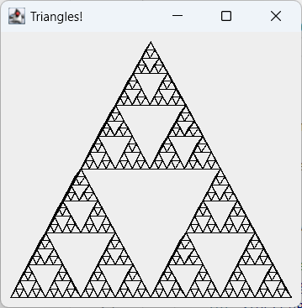
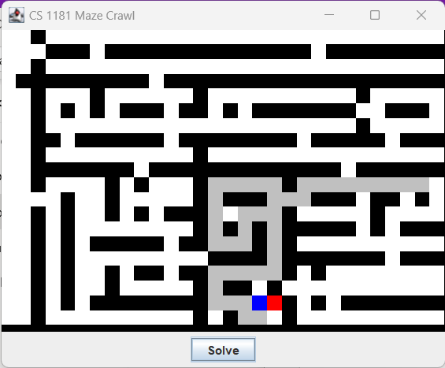
A few other examples

Slide 24
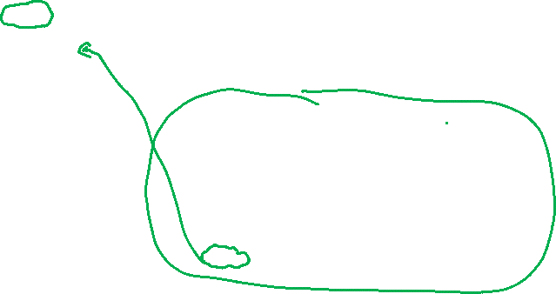
One variable or many
pots
public static String reverse(String theString){
if (theString.length() == 0){
return theString;
}
String firstChar = theString.substring(0, 1);
String theRest = reverse(theString.substring(1));
return(theRest + firstChar);
}
p
ots
ots
I only declared firstChar once. How can many firstChars be stored in memory?
public static String reverse(String theString){
if (theString.length() == 0){
return theString;
}
String firstChar = theString.substring(0, 1);
String theRest = reverse(theString.substring(1));
return(theRest + firstChar);
}

Slide 25
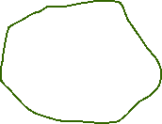

The Stack and The Heap
Computer memory is divided into to main regions:
The Stack – where local variables live
The Heap – where dynamic variables (anything that is created using new) live
Stack
Heap
Student me
= new Student(0011232, “mike”);
Name: “mike”
UID: 0011232

Slide 26
Stack Frames
Every time we call a new method, a stack frame is created with room for all:
All parameters passed to the method
All the method’s local variables
The methods return address, and
A few other things we won’t worry about until Computer Organization

Slide 27
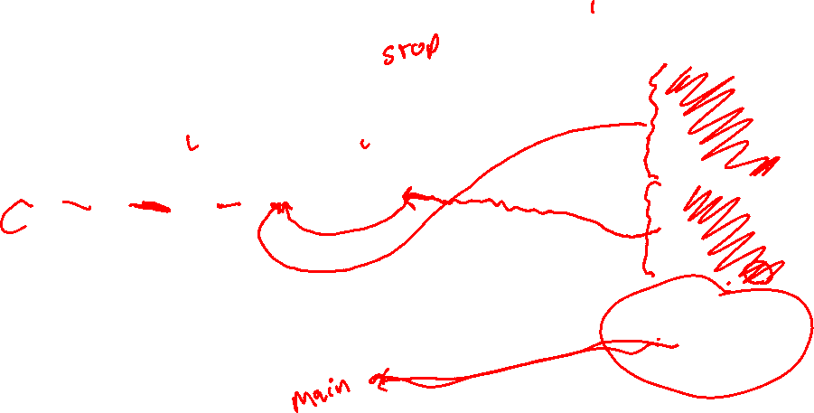
Stack Frames in Action
public static String reverse(String theString){
if (theString.length() == 0){
return theString;
}
String firstChar = theString.substring(0, 1);
String theRest = theString.substring(1);
return(reverse(theRest) + firstChar);
}
theRest: p
reverse (op)
firstChar: o
theString: op
theRest: op
reverse (top)
firstChar: t
theString: top
theRest: top
reverse (stop)
firstChar: s
theString: stop
main
Notes:
Trace with return addresses!

Slide 28
Which variables are on the stack?
class Student {
private ArrayList<Integer> grades;
private String lastName, firstName;
private int uid;
private double gpa;
…
public static void main(String[] args) {
Student s1 = new Student("Doe", "John", 19, 3.2);
s1.addGrade(90);
s1.addGrade(80);
}
}
Notes:
When you call a constructor or other method, those local variables are on the stack too!
Everything on the stack disappears when the function in which it is declared exits.

Slide 29

Test your understanding
Suppose the recursive method scramble is defined as follows:
public static String scramble(String theString){
if (theString.length() <= 1){
return theString;
}
String firstChar = theString.substring(0, 1);
String lastChar = theString.substring(theString.length()-1);
String scrambled = scramble(theString.substring(2));
return(lastChar + firstChar + scrambled);
}
What will be printed by the following instruction?
System.out.println(scramble("ABCDEF"));

